Slide 1


Social Media & Social Media Influencer Analysis
An in-depth analysis of social media influencers across various platforms

Slide 2
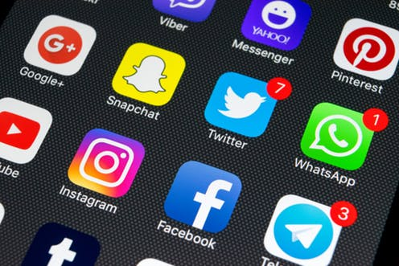
Social Media Platforms Analyzed
Instagram
YouTube
TikTok
This Photo by Unknown Author is licensed under CC BY-SA-NC

Slide 3





Analyzing Instagram
Engagement
Country
Audience/Followers

Slide 4
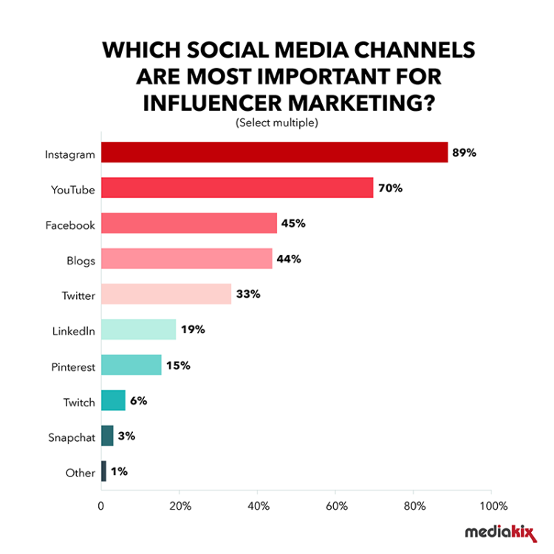
Instagram ranks number one as the most strategically influential social media platform for influencer marketing

Slide 5
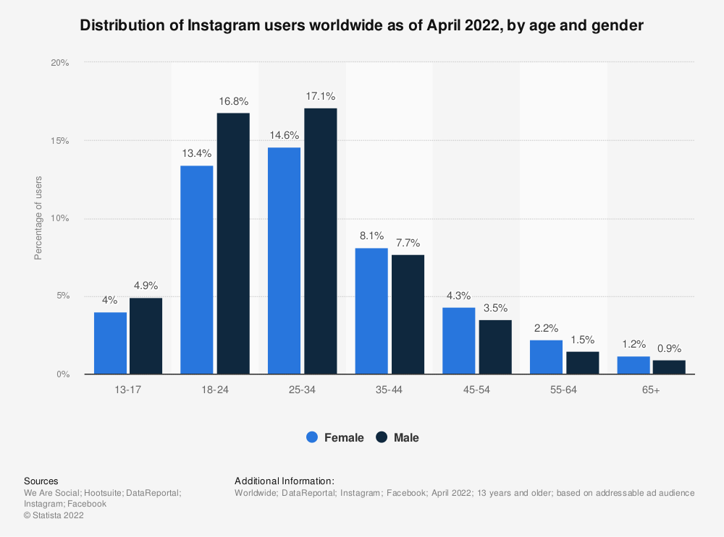
Distribution of Instagram users worldwide as of April 2022, by age and gender
There are over 2 billion Instagram users worldwide, as of late 2021, according to CNBC reports.
More than half of global Instagram users are aged 34 years or younger, with the largest age group being 18-34 years old, consisting of 62.2% of all users.

Slide 6
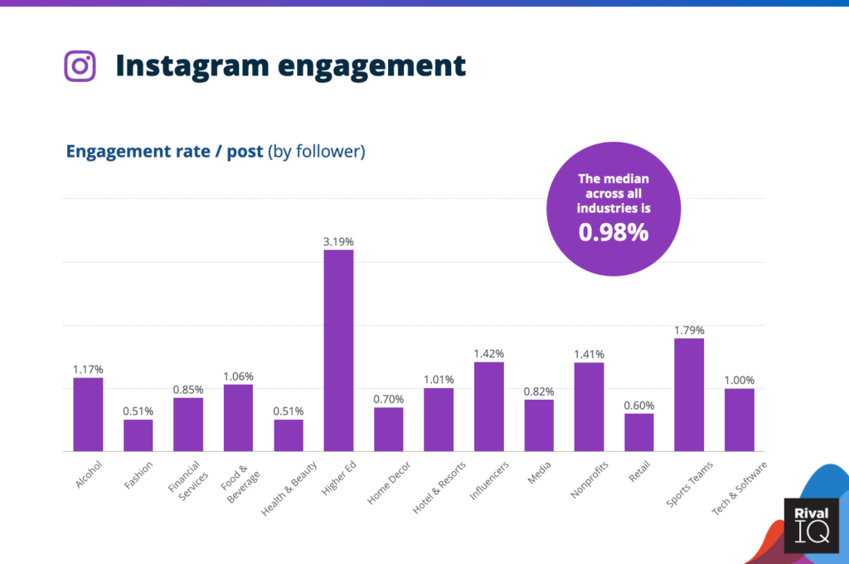
Instagram Engagement
The average engagement rate per post is 0.98%, with all Instagram influencers having an average engagement rate per post of 1.42%

Slide 7
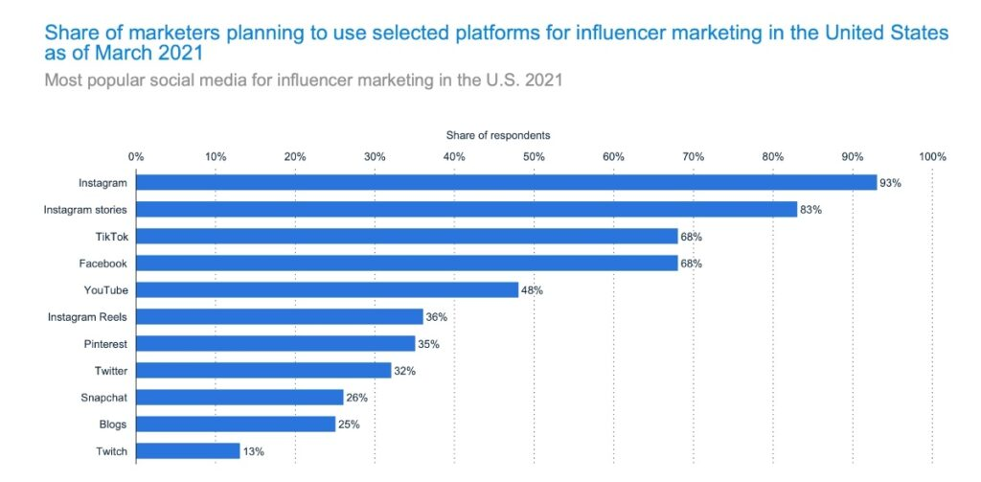
Influencer Marketing
About 93% of marketers plan to use Instagram for influencer marketing

Slide 8
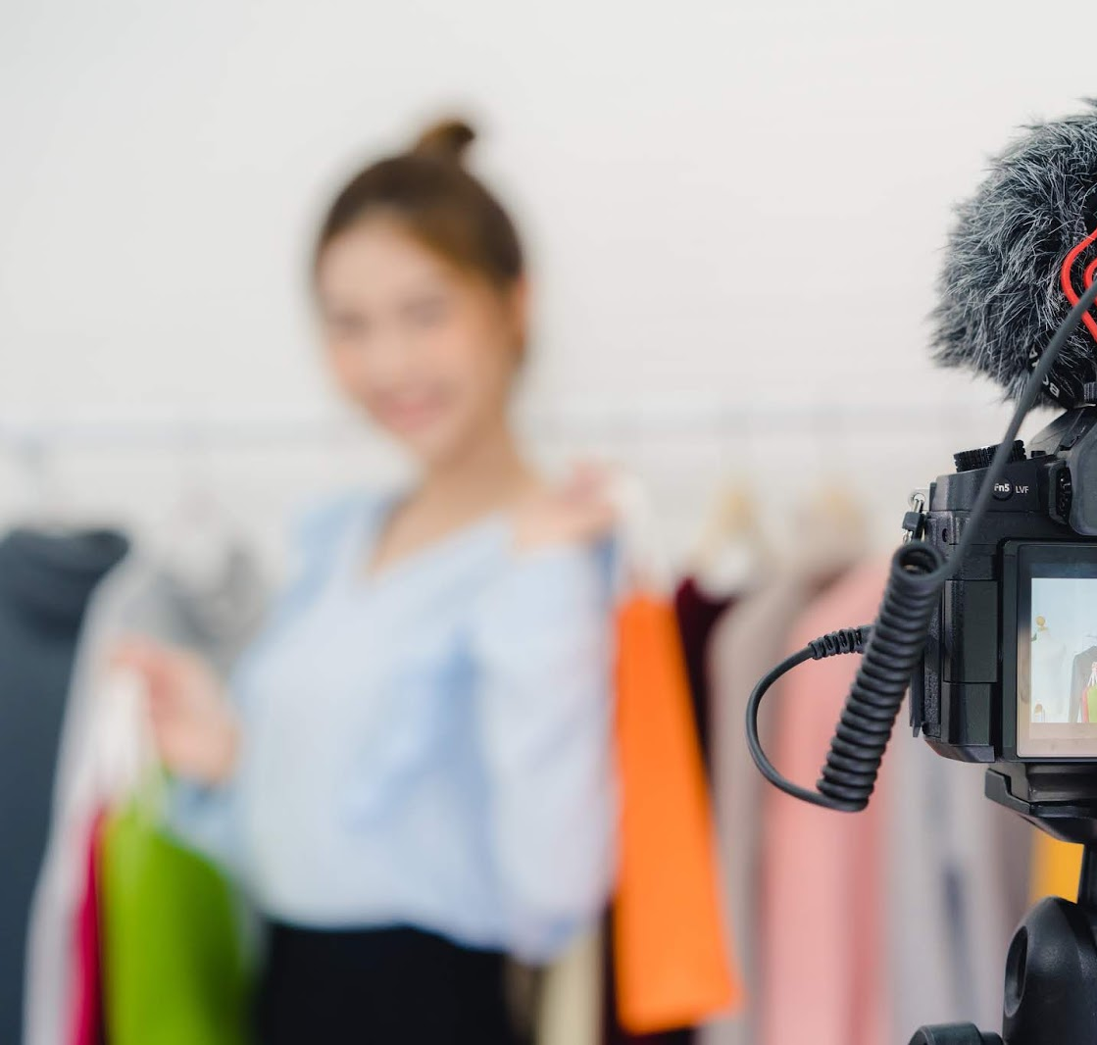
Key Instagram Influencer Marketing Statistics in 2023
Around 93% of total influencer marketing campaigns make use of Instagram
Since the COVID-19 pandemic, the content creation of Instagram influencers has increased by 50%
Sponsored posts on Instagram are encountering 76% more likes after the global COVID pandemic
Cristiano Ronaldo, the highest-paid Instagram influencer, charges 1,604,000 US dollars per post.
This Photo by Unknown Author is licensed under CC BY-SA

Slide 9
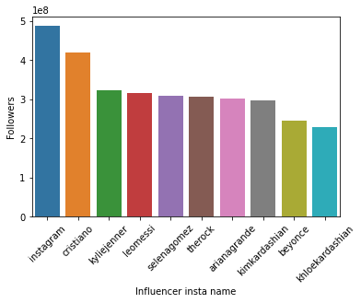
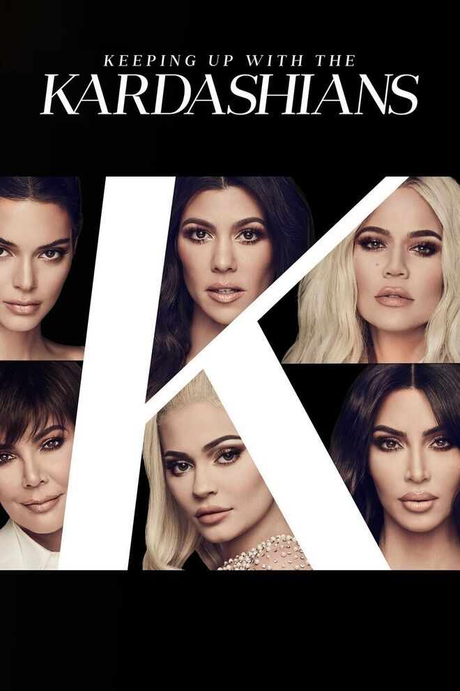
Top 10 Instagram Accounts by Number of Followers
Cristiano Ronaldo, the highest-paid Instagram influencer, charges 1,604,000 US dollars per post. He is also 2nd in the list of top 10 Instagram accounts by the number of followers
Instagram comes in first as the most followed Instagram account on the platform.
Three Kardashian relatives have made it onto the top 10 list
Kylie Jenner #3rd
Kim Kardashian #8th
Khloe Kardashian #10th
This Photo by Unknown Author is licensed under CC BY-SA

Slide 10
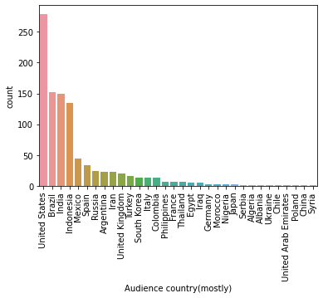
Top Countries According to Number in Audience
United States of America comes in first as the country with the highest number of Instagram users that follow the influencers that will be evaluated next
Brazil comes in second and India third.
It is expected that Syria has the least amount of influence in terms of audience number given their strict regulations of social media

Slide 11
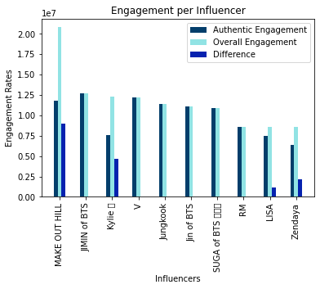
Top 10 Influencers with the Most Engagement: Authentic vs Overall
Authentic social media engagement is the practice of reaching out and attempting to make a sincere and genuine connection with someone on social networks through likes, retweets, shares, and most importantly comments and conversation
The influencer(s) with the highest authentic engagement was JIMIN of BTS, with the lowest being Zendaya.
The influencer(s) with the highest overall engagement was MAKE OUT HILL, with RM, LISA, and Zendaya having the least.
Equal authentic and overall engagement came from influencers such as V, Jungkook, Jin of BTS, SUGA of BTS, and RM.

Slide 12
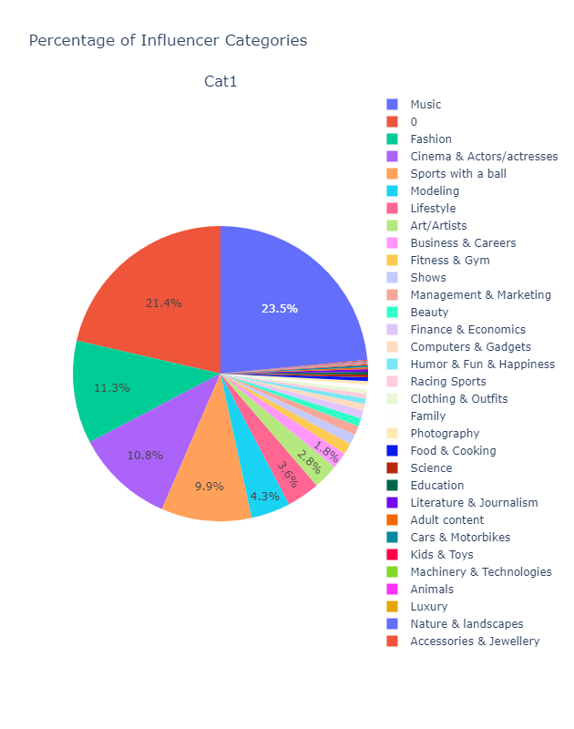
Percentage of Influencer Niches: Primary Categories
Nearly a quarter (23.5%) of primary categories for influencers was delegated to Music, more than likely indicating that social media presence is dominated by musicians, musical artists, and the like.
Approximately 21.4% of the total number of influencer accounts had no niche or category that separated them from the rest; this usually means that nearly another quarter of influencers do not work from a single niche but instead work from multiple niches (more than two)
Fashion was the niche or category that constituted 11.3% of influencers on Instagram coming in third to music and influencer accounts with no definitive niche

Slide 13
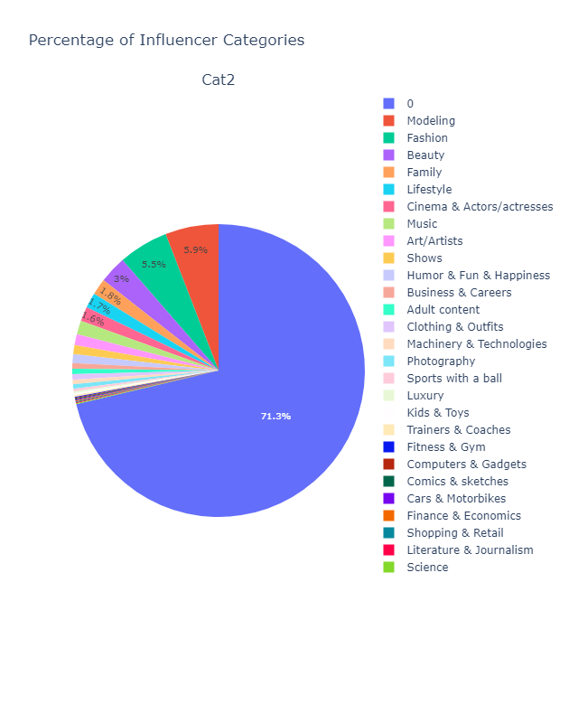
Percentage of Influencer Niches: Secondary Categories
Most influencer accounts did not have secondary niches, constituting a whopping 71.3% of the entire list of influencers recorded from early 2022
In the second place, modeling constituted 5.9% of influencer accounts with this secondary niche.
In third place comes fashion as the secondary niche to nearly 5.5% of influencer accounts recorded in early 2022.
The most popular primary niche was Music, and the most popular secondary niche was modeling. Chances are you are following someone who mixes modeling with music promotion and shows off their musical talents!
Fun Fact: Selena Gomez is number two in the most followed Instagram list but number one in the list of top Music influencers in the world. While most music influencers use their popularity to showcase their recent albums or promoted products, many also use social media to promote social causes. Selena partners with the anti-human trafficking organization A21, encouraging the cause.

Slide 14
Analyzing YouTube
Country
Engagement
Subscribers

Slide 15
YouTube ranks number two as one of the most strategically influential social media platforms for influencer marketing at 70%, a 19% difference from its more popular counterpart

Slide 16
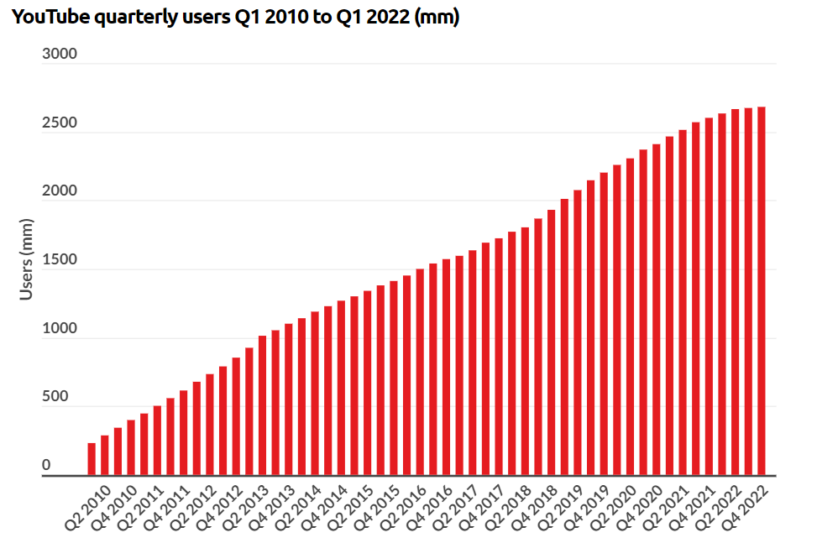
Quarterly Active YouTube Users…
According to the latest YouTube statistics, the video-sharing platform has 2.6 billion users worldwide as of 2022 (Statista, 2022). Ranked as the 2nd most popular social network and the only platform with more active users than YouTube is Facebook.

Slide 17
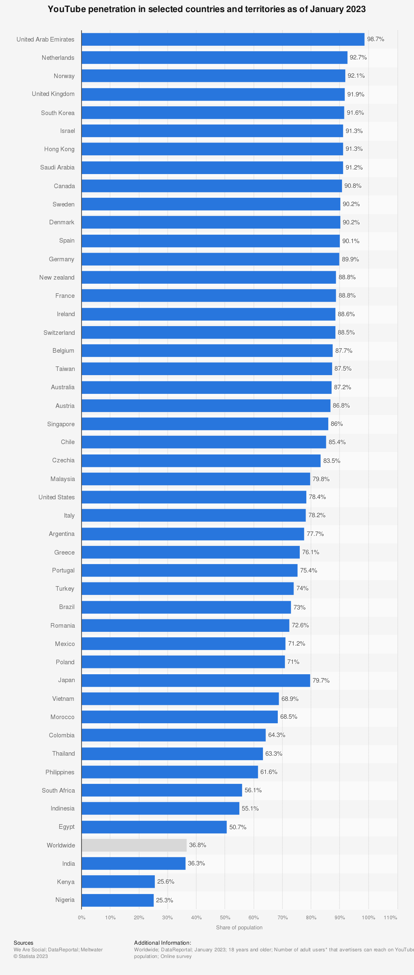
Social Media Penetration
62 percent of global consumers say they use YouTube.
Acting as one of Google’s subsidiaries, YouTube has provided fast and easy video access to users with the ability to share videos frequently—growing beyond expectation.

Slide 18
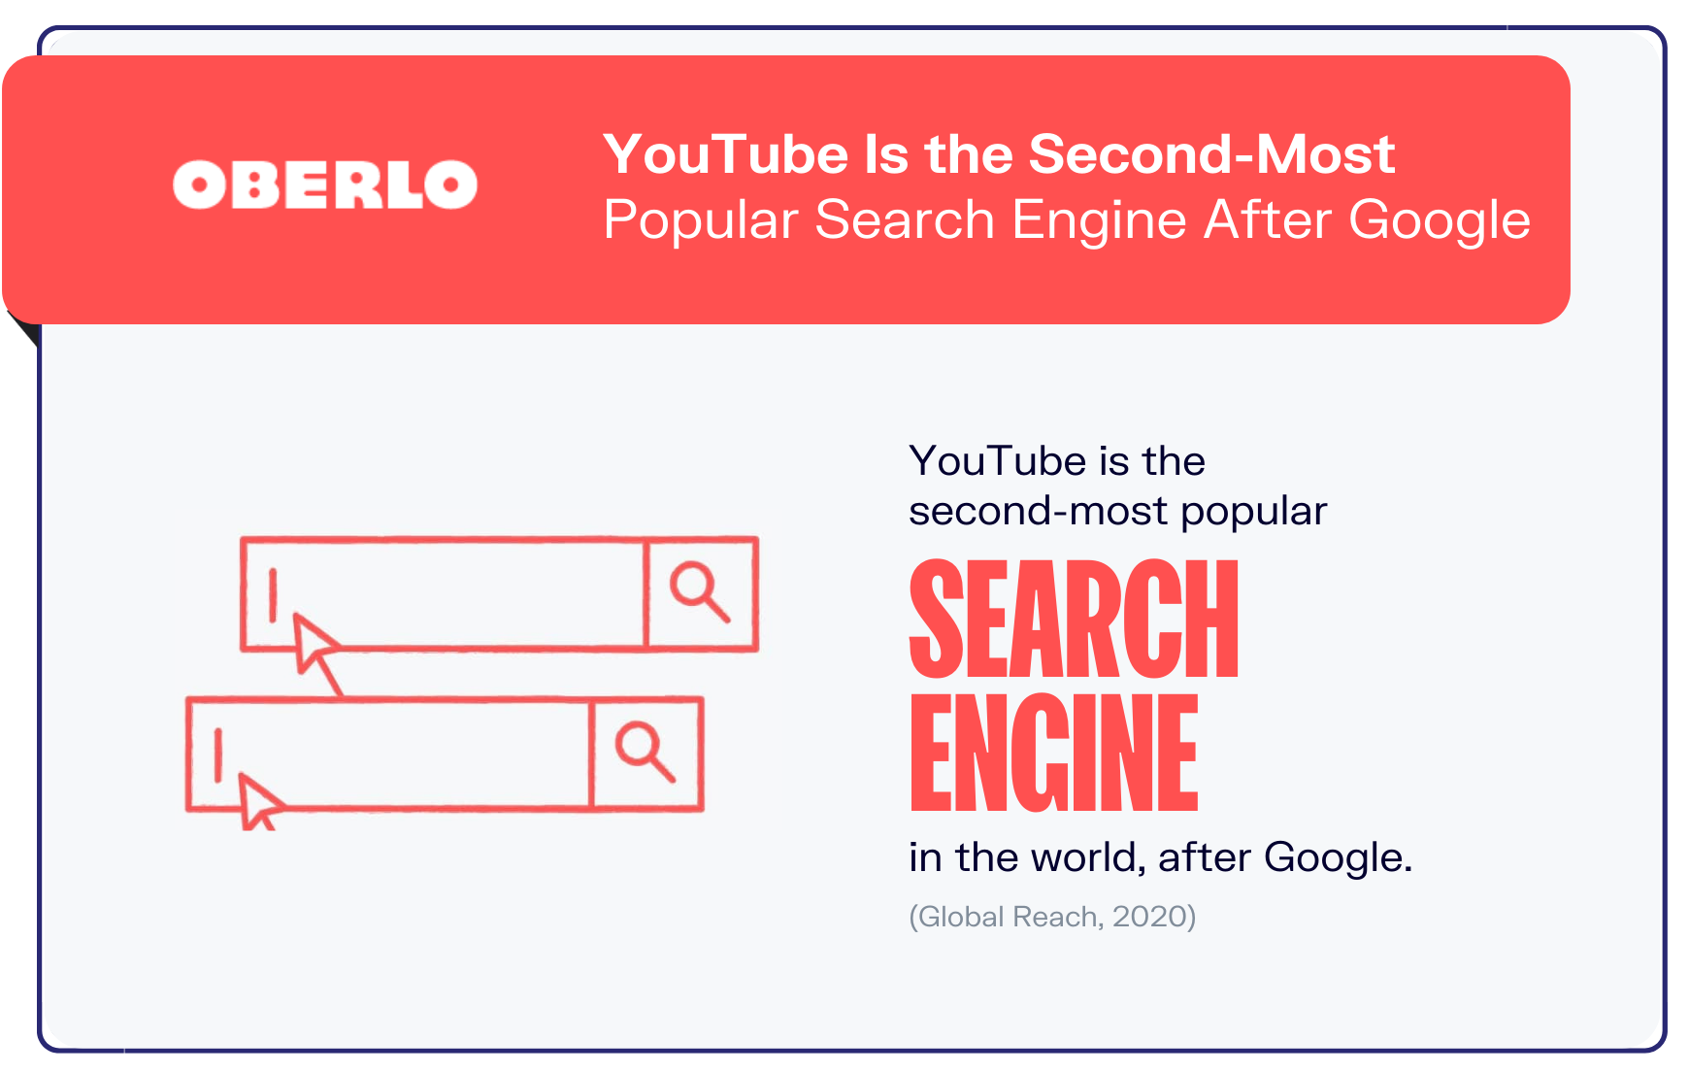
YouTube is the 2nd most popular search engine after Google
YouTube receives more searches per month than the likes of Microsoft Bing, Yahoo, AOL, and Ask.com combined.
YouTube viewers watch over one billion hours of videos on its platform every single day and are responsible for generating billions and billions of views.
The mobile-friendliness of the YouTube app is one of its most appealing factors and something influencers and brands take advantage of when advertising on YouTube.

Slide 19
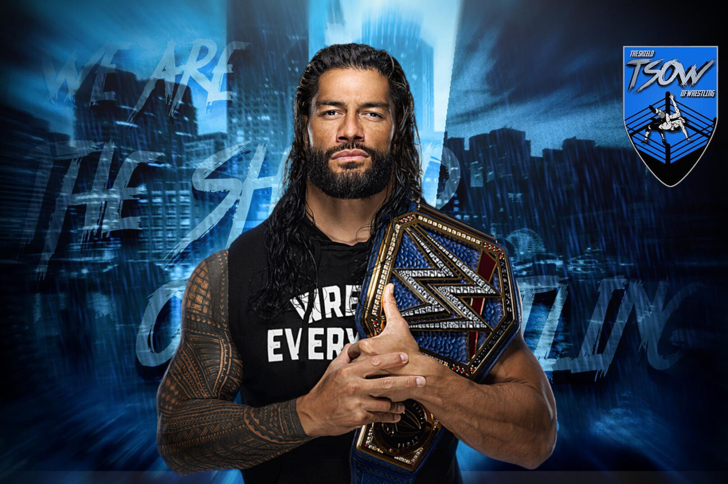
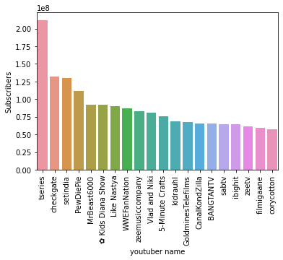
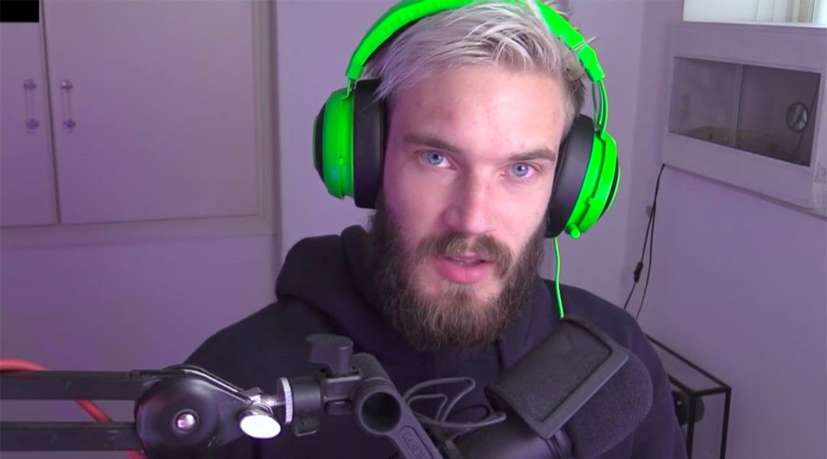

Most Subscribed YouTube Channels
To the left is a bar chart of the most subscribed YouTube channels as of 2022. The most followed YouTube channel, @tseries holds a whopping 212.1 million subscribers, with @checkgate coming in second at just over half of that—132.1 million.
My personal favorites, PewDiePie, WWEFanNation, and 5-Minute Crafts have also made the top 20 list of most subscribed YouTube Channels.
This Photo by Unknown Author is licensed under CC BY-ND
This Photo by Unknown Author is licensed under CC BY-SA-NC
This Photo by Unknown Author is licensed under CC BY-NC-ND

Slide 20
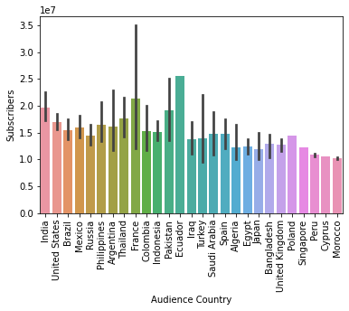
Number of YouTube subscribers per Country
In a list of the top 20 nations that utilize YouTube, the number of subscribers per country was analyzed from the YouTube dataset.
Ecuador, France, India, and Pakistan were among the top four countries with the highest numbers of YouTube subscribers globally.
The least number of YouTube subscribers per country came from Morocco, Cyprus, and Peru.

Slide 21
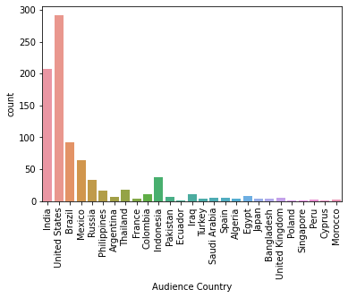
Number of Famous YouTube Channels from Different Countries
Most of the high-ranking YouTube channels in terms of popularity come from the United States in the list of top 20 nations with the most notable YouTubers.
In 2nd place comes India, with the least number of popular YouTubers coming from Poland, Singapore, Ecuador, and Cyprus.
In 3rd place comes Brazil for the country with the 3rd highest number of notable YouTubers that have made it into this 2022 YouTube dataset.

Slide 22
Analyzing TikTok
Country
Engagement
Followers

Slide 23
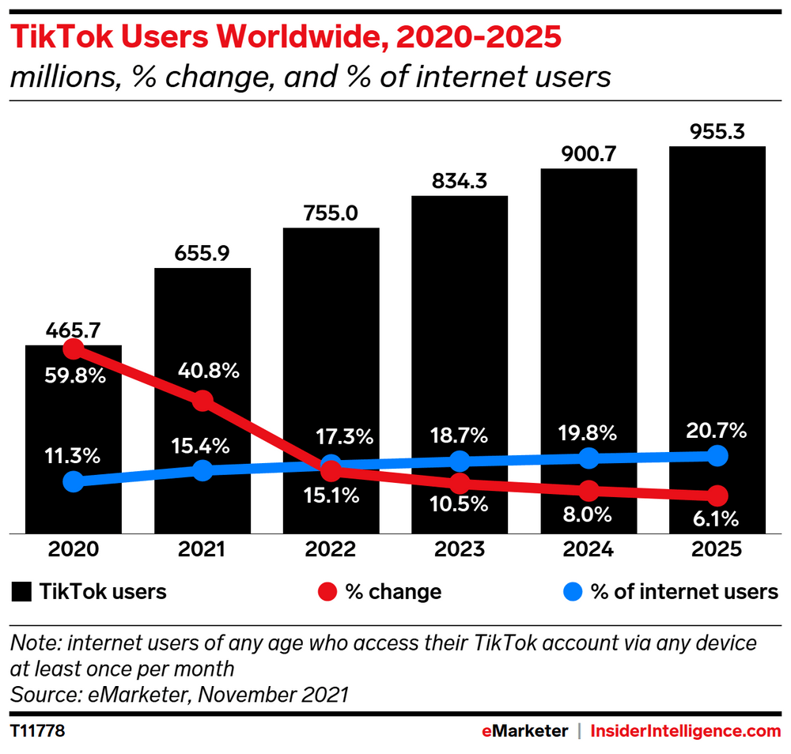
How Many Users Does TikTok Have?
Launched in September 2016, TikTok's explosion in popularity has been notable amidst social media platforms and users everywhere.
The latest TikTok statistics as of July 2022 state that the platform has over one billion monthly active users worldwide, making it the 7th most popular social media platform in terms of users, ahead of others that have been around much longer such as Snapchat, Pinterest, and Twitter.

Slide 24
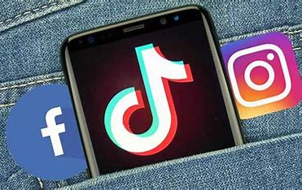
COMPARISONS
To give an idea of how other apps performed in comparison with TikTok’s growth, it took Instagram 7.7 years from its launch to hit the one-billion user mark. Facebook, widely known as the king of social media, took 8.7. The only social media platform to reach this milestone quicker than TikTok is Facebook Messenger.

Slide 25
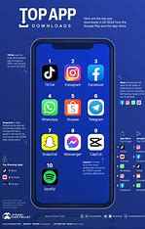
Most Downloaded App on the Apple App Store
Statistics
TikTok is the most downloaded app on the Apple App Store in Q2 2022, with over 60 million downloads in a single quarter on iPhone and iPad devices, beating out CapCut, Google Maps, YouTube, and Instagram, which round out the top five.
In comparison, TikTok is the 3rd most downloaded app on Google Play behind Facebook and Instagram with 125 million downloads by Android users in Q2 2022.
With around 187 million downloads in Q2 2022 worldwide, TikTok beats Instagram as the most downloaded app worldwide. More impressively, it’s the eighth time in the last ten quarters that TikTok has topped the charts.

Slide 26
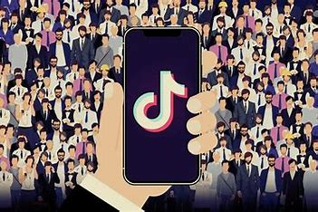
TikTok’s Permeability & Popularity
62 percent of TikTok users in the US are aged between 10 and 29. In comparison, 7.1% of them are over the age of 50.
As of 2019, TikTok is available in 155 countries and in 75 languages, covering a large portion of the population.
Americans love TikTok—about 26.5 out of the 500 million monthly active users are from the USA, combining downloads of TikTok from both Android and iOS.
14.3 million US adults use TikTok as of September 2018 and continues to increase onward

Slide 27
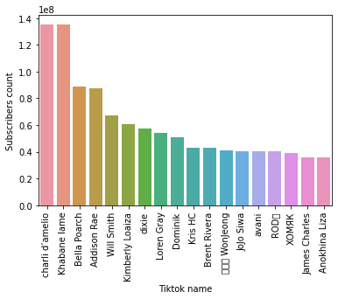
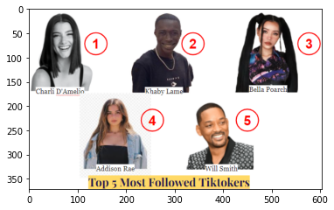
Top 20 Most Followed TikTok Accounts
Charli D’Amelio (1st)and Khabane Lame (2nd) are nearly neck and neck for the most followed TikTok content creators as of 2022.
Bella Poarch, Addison Rae, and Will Smith in addition to the first two content creators mentioned constitute the top 5 most followed TikTok accounts for the year 2022.

Slide 28
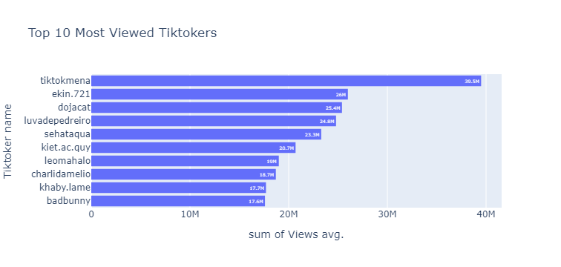
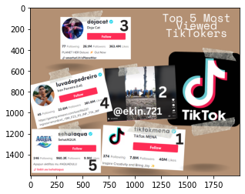
Top 10 Most Viewed TikTokers
In terms of the most viewed TikTok accounts that exist on the platform, at the top of the list is @tiktokmena with nearly 39.5 million views.
Singer/Songwriter Doja Cat comes in 3rd, another one of my personal favorites.
Surprisingly Khabane Lame and Charli D’Amelio come in second and third to last in the top 10 list of most viewed Tiktokers—contrary to their follower status.

Slide 29
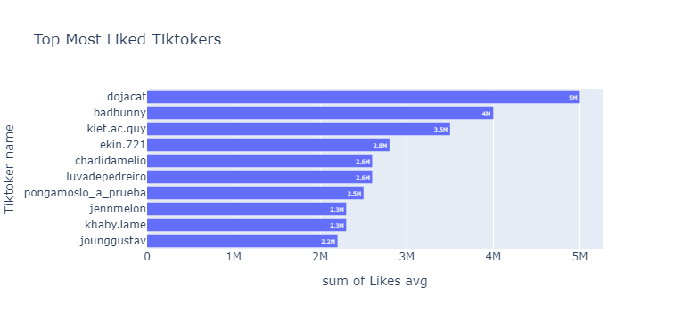
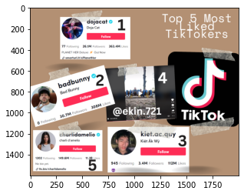
Top 10 Most Liked TikTokers
Doja Cat comes in first as the most Liked Tiktoker on the social media platform
Charli D’Amelio comes in 4th place, while Khaby.Lame comes in second to last in the Top 10 List of Most Liked TikTokers.
Another musical artist, BadBunny is second on the top 10 list, after Doja Cat.

Slide 30
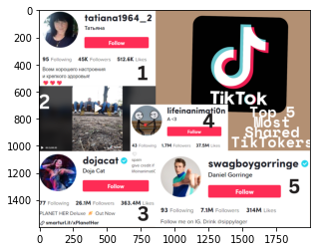
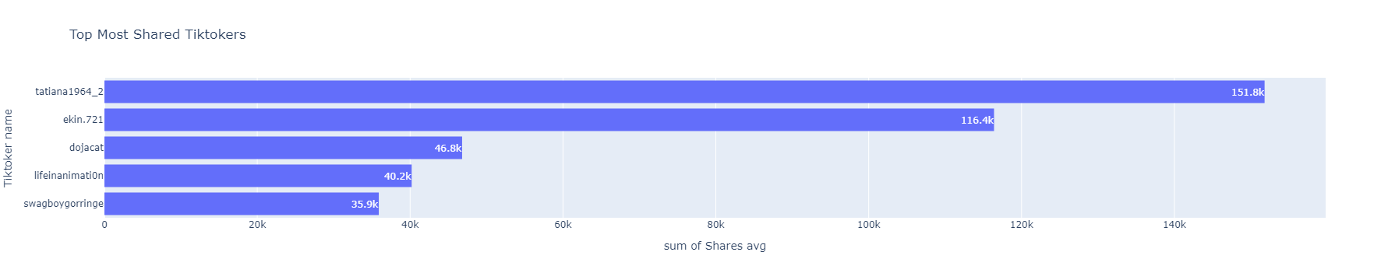
Top 5 Most Shared TikTokers
In the top 5 most shared TikTokers globally, tatiana1964_2 was the most shared TikToker, followed by Doja Cat in 3rd place.
TikTok users watch 1 million videos on the app every day, according to Oberlo’s article, 10 TikTok Statistics, 10 TikTok Statistics You Need to Know

Slide 31
How Much do TikTokers Make?
Here’s how much TikTok influencers earn per sponsored post as of 2023:
Charli D’Amelio $105,770
Khaby Lame $92,270
Bella Poarch $66,829
Addison Rae $65,194
Will Smith $53,741

Slide 32
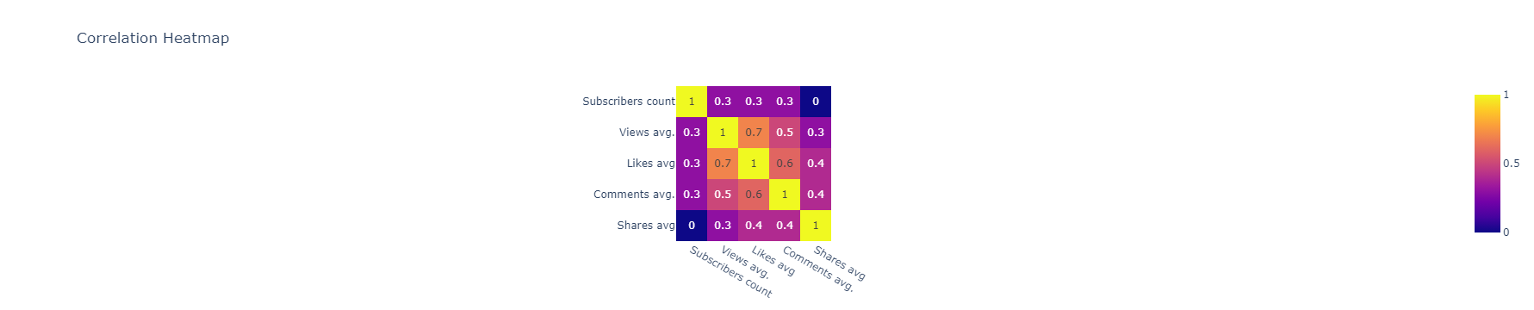
How much influence do these factors have on each other?
Subscribers to:
Average Views → 30% influence
Average Likes → 30% influence
Average Comments → 30% influence
Average Shares → 0% influence
Average Views to:
Subscribers → 30% influence
Average Likes → 70% influence
Average Comments → 50% influence
Average Shares → 30% influence
Average Likes to:
Subscribers → 30% influence
Average Views → 70% influence
Average Comments → 60% influence
Average Shares → 40% influence
Average Comments to:
Subscribers → 30% influence
Average Views → 50% influence
Average Likes → 60% influence
Average Shares → 40% influence
Average Shares to:
Subscribers → 0% influence
Average Views → 30% influence
Average Likes → 40% influence
Average comments → 40% influence
Notes:
When determining what factors each of these variables play in each other’s success or current status, it was found that the number of TikTok followers influenced the average number of views, likes, and comments by 30%, but had no effect on the number of average shares per TikTok account.
The average number of views has a 70% correlation to the average number of likes, and the average number of comments by 50%--meaning that the more views, the more likes and that the number of comments has a 50% chance of being influenced by the average number of views.
The average number of comments is heavily and positively influenced by the average number of likes by 60%, so the more likes, the more comments. Meanwhile, the average number of likes has a 40% influence on whether a TikTok will be shared. So, the more likes, the closer the likelihood of that TikToker being shared.

Slide 33
Summary & Conclusion
In terms of the number of users, Instagram ranks number one as the most strategically influential social media platform for influencer marketing
YouTube ranks number two as one of the most strategically influential social media platforms for influencer marketing at 70%, a 19% difference from its more popular counterpart
TikTok is the most downloaded app on the Apple App Store in Q2 2022, with over 60 million downloads in a single quarter on iPhone and iPad devices, beating out CapCut, Google Maps, YouTube, and Instagram, which round out the top five.
Influencers who would like to gain more reach, should try these three top-performing and popular social media platforms

Slide 34
References
Chen, J. (2022, December 12). Instagram statistics you need to know for 2022. Sprout Social. Retrieved February 4, 2023, from https://sproutsocial.com/insights/instagram-stats/
Jas, R. (2022, December 27). Social Media Influencers in 2022. Kaggle. Retrieved February 4, 2023, from https://www.kaggle.com/datasets/ramjasmaurya/top-1000-social-media-channels
Mohsin, M. (2022, December 31). 10 tiktok statistics you need to know in 2022 [new data]. Oberlo. Retrieved March 11, 2023, from https://www.oberlo.com/blog/tiktok-statistics
Mohsin, M. (2022, December 31). 10 YouTube statistics that you need to know in 2022. Oberlo. Retrieved March 11, 2023, from https://www.oberlo.com/blog/youtube-statistics#:~:text=According%20to%20the%20latest%20YouTube%20statistics%2C%20the%20video-sharing,has%20more%20active%20users%20than%20YouTube%20is%20Facebook.
Wise, J. (2022, December 4). Instagram influencer marketing statistics 2023: How big is it? EarthWeb. Retrieved February 4, 2023, from https://earthweb.com/instagram-influencer-marketing-statistics/

Slide 35

Thank You!
someone@Example.com

